Slide 1
Pareto Diagram Case Study
Masters in data science

Slide 2
Case study - 1
The city apollo hospital must analyze and solve the various complaints of the patients, which are submitted to the head nurse office. In order to analyze the complaints and claims we use the pareto diagram. In our case, we consider 845 received complaints, starting from the complaint forms filled in by the medical service beneficiaries, which were grouped in the following categories:

Slide 3
Note:
1. A step by step analysis is to be shown. Also remember proper interpretation of the result is to be shown.
2. Chart should be properly colored as per the brand mentioned in the problem.
3. Each detailed aspect should be properly checked based on the case study.
4. After your analysis only presentation is to be submitted, no excel sheet.
5. Presentation should be properly designed based on the brand mentioned.

Slide 4
Solution
As mentioned in the case study, there were all the data related to complaints are provided categorically.
First of all the data should be aligned in decreasing order on the basis of number of complaint.
A cumulative frequency is calculated for number of complaint.
A cumulative percentage is calculated basis on cumulative frequency.
Category | Number of Complaints | Cumulative Frequency | Percentage
Solving Time | 320 | 320 | 38%
Information Provided | 210 | 530 | 63%
Received treatment | 92 | 622 | 74%
Too Many formalities | 75 | 697 | 82%
Time Table | 60 | 757 | 90%
Waiting Line Time | 53 | 810 | 96%
Personel Skills | 18 | 828 | 98%
Form missing | 13 | 841 | 100%
Other | 4 | 845 | 100%
Total | 845

Slide 5
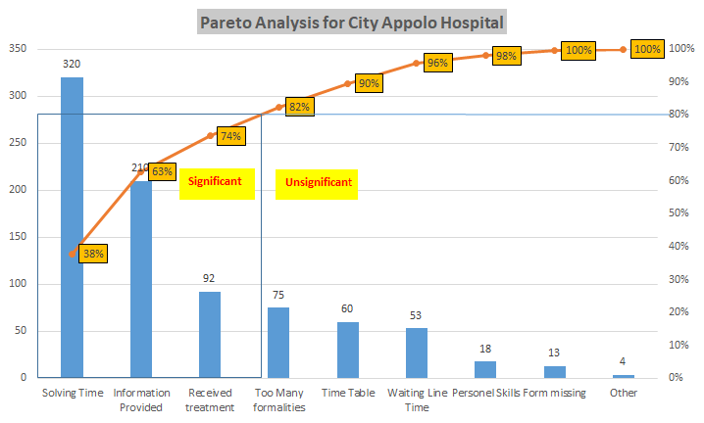
Based on the data analyzed, A Pareto analysis is conducted.
Pareto diagram shows that complaints categories such as Solving Time, Information provided and Received Treatment are significant complaints categories. Hospital should resolve these issues on high priority.
By resolving these issues on high priority, the hospital will be able to eliminate the 80% of high risk issues.

